Slide 1


BANK OF BARODA HACKATHON - 2022
Technology Partner
YOUR TEAM NAME :ENERGETIC ENGINEERS
YOUR TEAM BIO :
THINK EFFICIENTLY AND WORK DEDICATEDLY

Slide 2

ABSTRACT
An Avatar is a computer representation of users in a computer generated 3D world, used primarily in chat and entertainment websites.
Images created by a computer that appear to surround the person looking at them and seem almost real.
Virtual Avatar is a simulated experience that can be similar to or completely different from the real world.
Minimal Angle of Resolution (MAR) refers to the minimum distance between two display pixels. At the distance, viewer can clearly distinguish the independent pixels. Often measured in arc-seconds, MAR between two pixels has to do with the viewing distance.

Slide 3
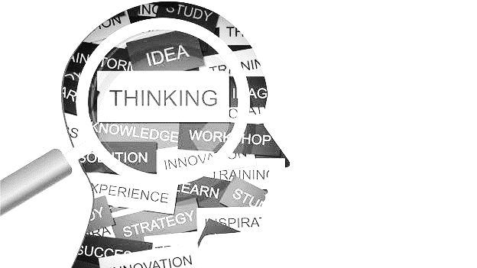
PROBLEM STATEMENT
Why did you decide to solve this Problem statement?
We decided to solve this problem statement :
To reduce the man power .
To consume the time.
Found more content value in this idea .
It will be very useful to the next generation users who will be well-versed in virtual learning .
All other fields are ready to implement the concept of virtual reality in future.
And we are trying to implement this concept in banking.
This process can be implemented even when there is no man to man connection.
This concept can be used to increase the capital by minimising the expenses.

Slide 4
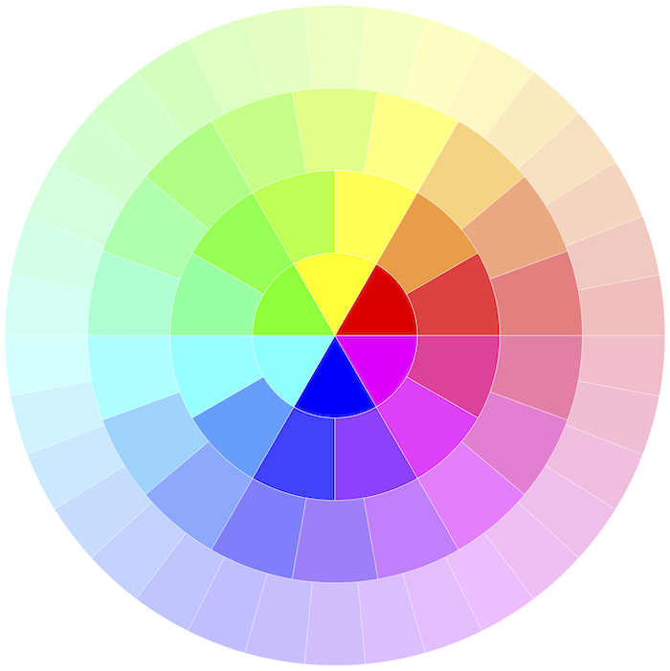
USER SEGMENT & MAIN POINTS
Which user /advertiser segment would be early adopter of your product & why?
Virtual avatar concept will easily be adopted by the users .
Work will be done on time without any delay for the users/servers .
Here the sponsors or producers act as mediators between bank and the customers by adopting different marketing strategies and providing fund for the project.
Both the bank and the customers will be benefitted by this concept.

Slide 5

PRE-REQUISITE
What are the alternatives/competitive products for the problem you are solving?
Holography is a technique that enables a wave front to be recorded and later re-constructed.
Holography is best known as a method of generating three-dimensional images .
In principle, it is possible to make a hologram for any type of wave.
It can be used in banking but it is more advanced when compared to virtual reality.
At the same time people of today’s generation will not be that much capable of accessing Hologram.
Virtual Avatar Concept might be a stepping stone to Hologram .

Slide 6

AZURE TOOLS OR RESOURCES
Azure tools or resources which are likely to be used by you for the prototype, if your idea gets selected.
Virtual avatar can be stored using Cloud computing (Azure tools) .
And this can be retrieved in upcoming days by using internet.
For storing data, Azure tools is having various data tools to save the implemented prototype .

Slide 7

ANY SUPPORTING FUNCTIONAL DOCUMENTS
Present your solution, talk about methodology, architecture & scalability
SOLUTION :
Virtual avatar is the best way to make users to easily connect with the bank staff digitally.
It will overcome the major signature process done manually by the staff. It will help to pass the cheque or verify the form in a digital way.
The users who are unaware of bank rules and regulation can easily go through this inconvenience by using virtual contact with the bank.
This will increase the bank ID users.

Slide 8

METHODOLOGY:
This concept and script can be written and implemented easily using Python language .
The avatar can be created and designed using Blender application software .
Artificial Intelligence technology can also be applied in this concept .
By using CGI (Computer Generated Imagery) special visual effects done by computer software , the user’s face structure is idealized and copied as original or animated form which is allowed to see in the display.
An audio or text is given as input to the program .
And this input will be delivered with the combination of CGI in the display along with the given audio or text as hearable.
These are the basic methods to implement the concept of virtual avatar.

Slide 9
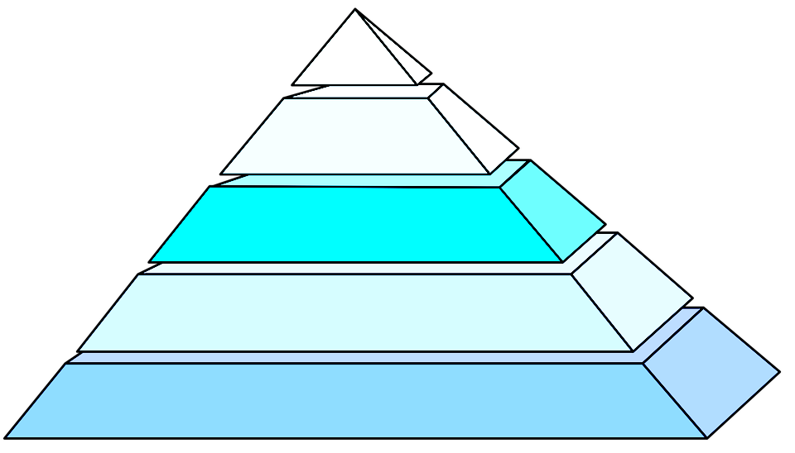
ARCHITECTURE :
The structure of virtual world is quite new to this environment.
This method is rising in selected fields like Airports, computer software industries and companies etc…..
Virtual contact is used in banks for staff to staff connection.
We are here to implement this method for bank to user connection which will make an understandable relationship between the user and the bank

Slide 10
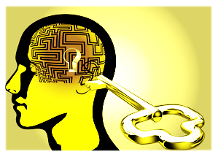
KEY DIFFERENTIATORS & ADOPTION PLAN
How is your solution better than alternatives and how do you plan to build adoption?
This will be the first stage of implementing Hologram in future.
This will be used to improvise the digitalization of banking

Slide 11
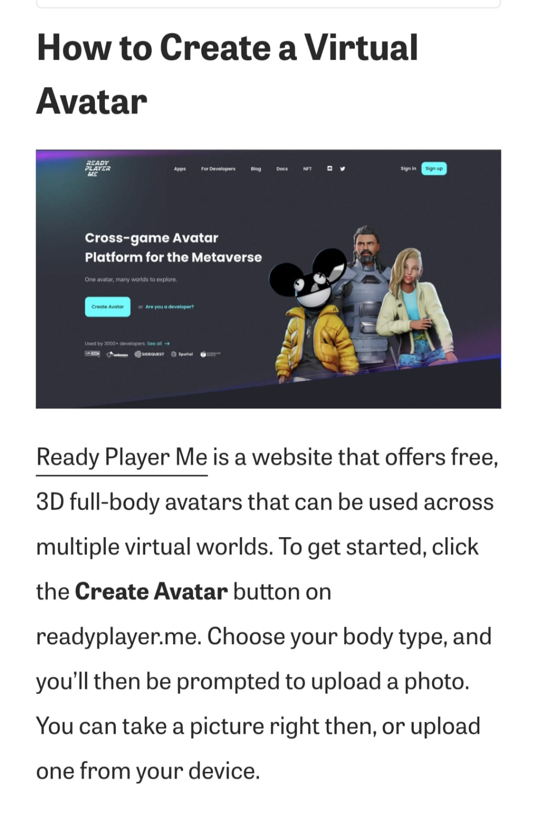
GITHUB REPOSITORY LINK & SUPPORTING DIAGRAMS, SCREENSHOTS, IF ANY
SCREENSHOTS :

Slide 12
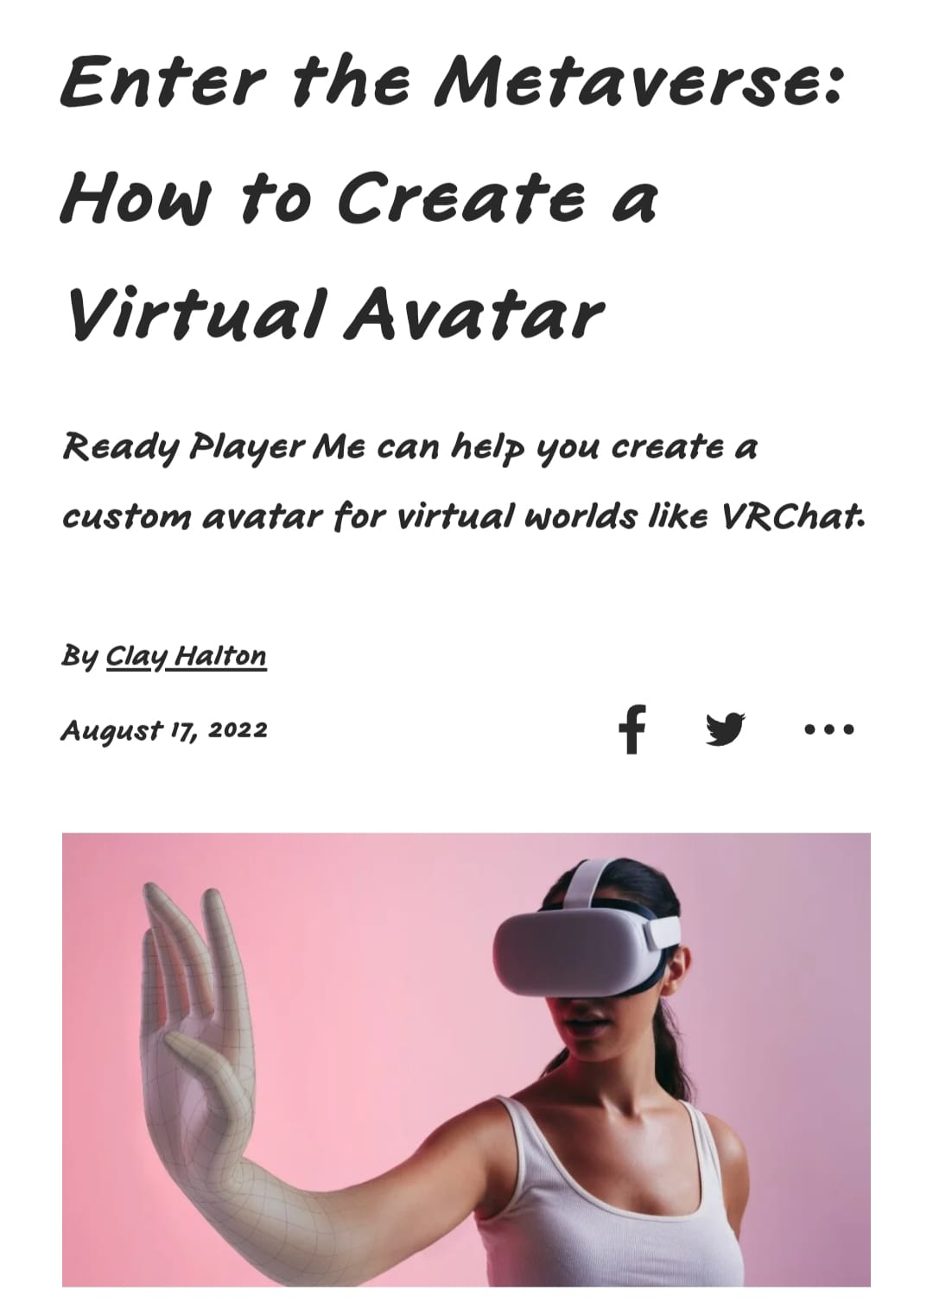
SCREENSHOTS :

Slide 13
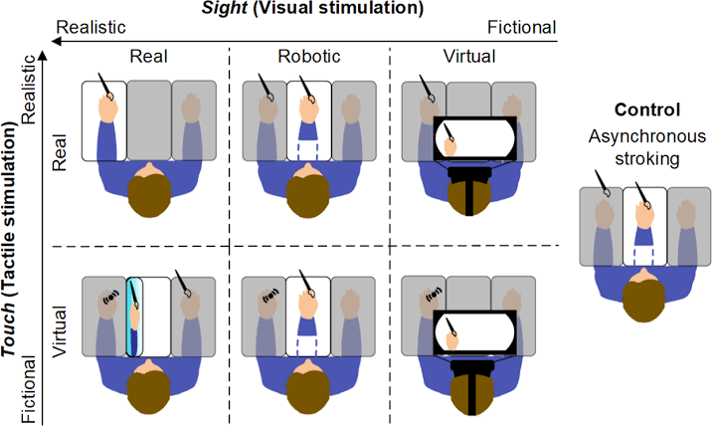
SUPPORTING DIAGRAMS

Slide 14
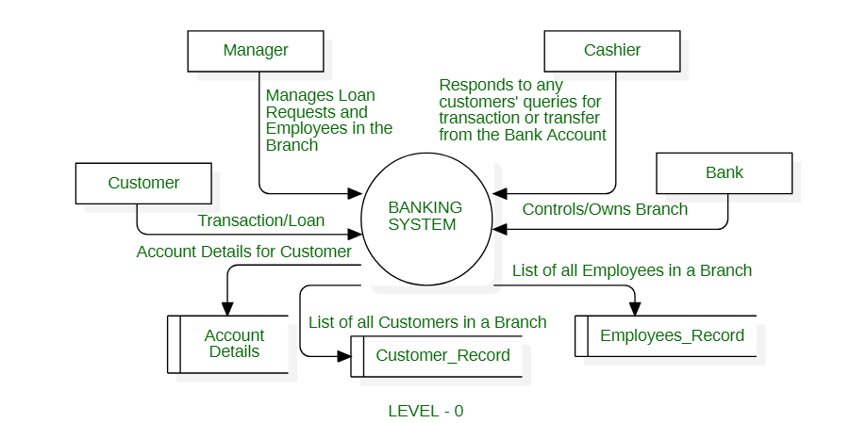
FLOWCHART :

Slide 15

How far it can go ?
Banks and financial services often need to present complex financial data to their clients and customers.
VR enables companies to create content as well as applications that present complicated financial data in an interactive and visually appealing manner.
VR helps banks in creating immersive experiences that improve user engagement.
For instance, businesses can educate customers about the stock market and investments using interactive VR apps.
Financial services and banking companies can also enhance certain aspects of their user experience.

Slide 16
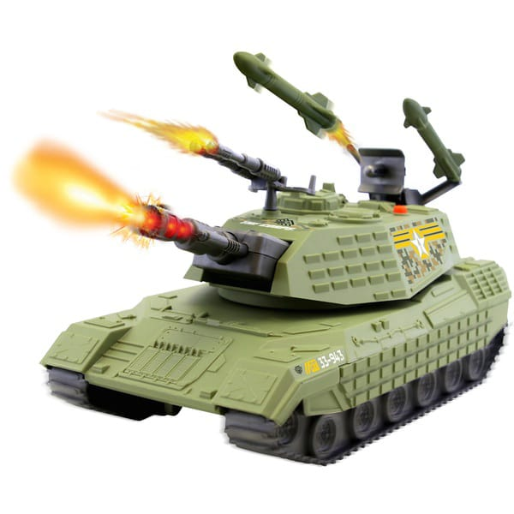
1. VR IN MILITARY
VR proves an effect method of training.
VR can transport a trainee into a number of different situations, places and environments for a range of training purposes.
The military uses it for flight simulations, battlefield simulations, medic training, vehicle simulation and virtual boot camp, among other things.
VR is a completely immersive, visual and sound-based experience, which can safely replicate dangerous training situations to prepare and train soldiers, without putting them at risk until they are ready for combat, it can also be used to teach soldiers some softer skills, including communication with local civilians or international counterparts when out in the field.

Slide 17
VR IN MILITARY (CONT..)
Another of its uses includes treating Post-Traumatic Stress Disorder (PTSD) for soldiers who have returned from combat and need help adjusting to normal life situations; this is known as Virtual Reality.
Exposure Therapy (VRET).
A key benefit for using virtual reality technology in the military is the reduction in costs for training.

Slide 18
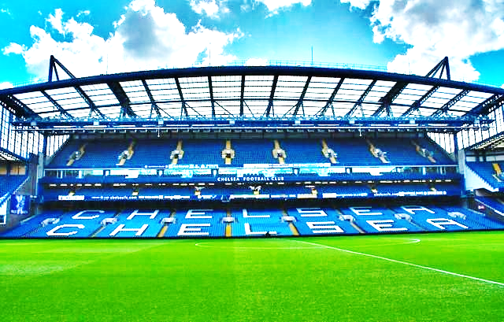
2. VR IN SPORT
It’s used as a training aid to help measure athletic performance and analyse technique.
Some say it can also be used to improve athletes' cognitive abilities when injured, as it allows them to experience gameplay scenarios virtually.
Potentially, this could also allow for those who cannot afford to spend money on attending live sports events to feel included as they can enjoy the same experience remotely, either for free or at a lesser cost.

Slide 19

3. VR IN MEDICAL TRAINING
Due to its interactive nature, medical and dental students have begun to practice surgeries and procedures using VR .
The risk of inflicting harm or making a mistake while practicing on real patients is eliminated.

Slide 20

4. VR IN EDUCATION
VR is extended to schools which are also adopted in education for teaching and learning situations.
Students are able to interact with each other and within a three-dimensional environment.
They can also be taken on virtual field trips, for example, to museums, taking tours of the solar system and going back in time to different eras.
Virtual reality can be particularly beneficial for students with special needs, such as autism.
Research has found that VR can be a motivating platform to safely practice social skills for children, including those with Autism Spectrum Disorders (ASD).

Slide 21

5. VR IN FASHION
A lesser known use of VR is in fashion where it has actually been having quite a profound impact.
For example, virtual simulations of store environments can be extremely useful for retailers to design their signage and product displays without fully committing to the build like you would in the real world. In the same way, appropriate time and resources can be allocated for the build of the store layout.
VR uses for these big names encompass offering a 360-degree experience of fashion shows and allowing customers to try on clothes virtually.
-

Slide 22
Thank You
TEAM MEMBER NAMES
HARINI G R KARTHICK MANIKANDAN E
HARINI SHREE A ADHITHIAN R

